Slide 1
Team 7
Kaustubh Kulkarni
Pranav Dhapke
Tanvi Deo
Nikhil Chavan

Slide 2

Ohhhh!!! No more grocery available…

Slide 3
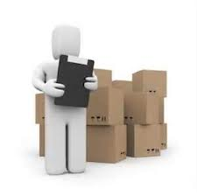
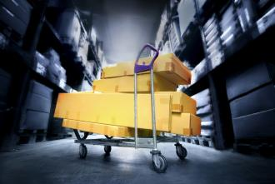
If you are Store Owner and you can not properly manage your Inventory according to demand and supply!

Slide 4

Don’t worry…
We have the SOLUTION!!!

Slide 5
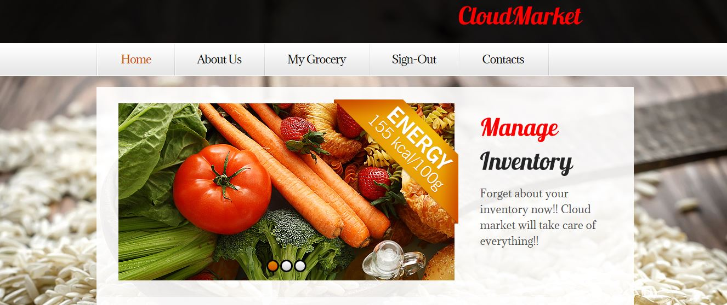
CLOUDMARKET

Slide 6

CloudMarket Network Architecture Overview
User 1
User 1
RFID
GATEWAY
DB
User 2
RFID
CloudMarket Server
DB
INTERNET
CLOUD
User 3
RFID
GATEWAY
Store Manager
User 4
RFID
Step 1 : User places RFID and sets threshold

Slide 7
CloudMarket Network Architecture Overview
User 1
User 1
RFID
GATEWAY
DB
User 2
RFID
CloudMarket Server
DB
INTERNET
CLOUD
User 3
RFID
GATEWAY
Store Manager
User 4
RFID
Step 2 : Store manager checks request from cloud market app and sends required grocery to user

Slide 8
Benefits To Customers
Grocery will never go out of stock.
Get your grocery at doorstep.
Set your grocery requirement as per your need.
Manage your grocery from anywhere.

Slide 9
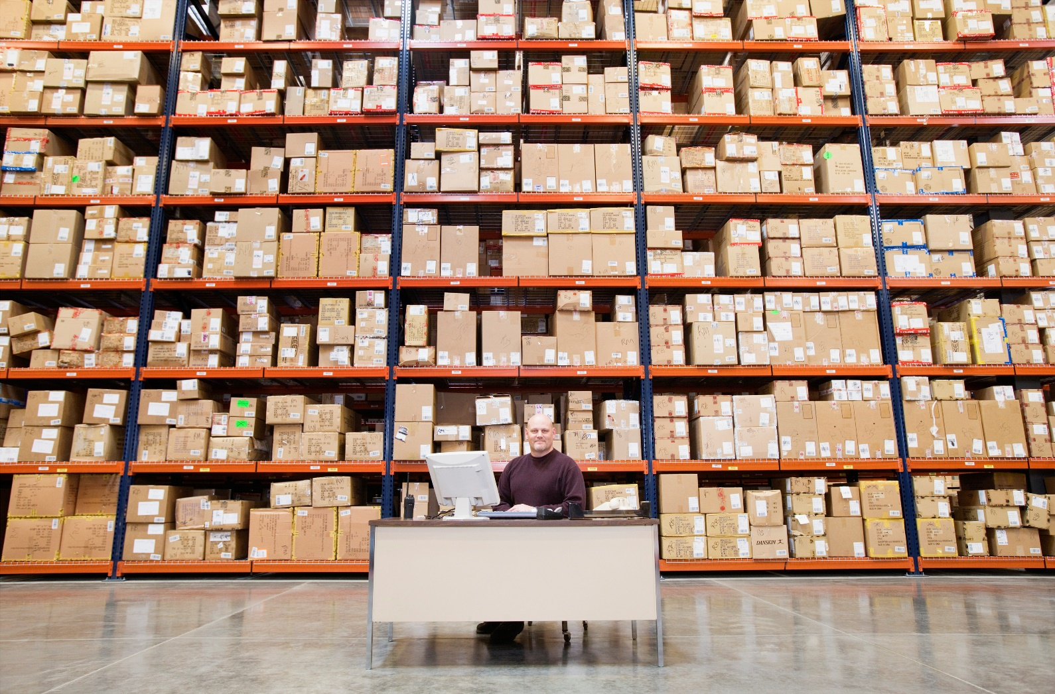
Inventory well managed is Inventory under control!

Slide 10
Benefits To Store Manager
Store Manager will be able to plan customer’s requirements ahead.
Store Manager will easily understand the need and demand from customers.
Data analysis through Graphs.
Store manager can analyze data and can preorder items from vendors according to need.

Slide 11
Technologies
NODE.JS
MYSQL
Cloud Platform
Amazon Web Services EC2
Testing Tool
Apache jMeter
Third Party API Service
Google Visualization API

Slide 12
DEMO

Slide 13
Performance Testing
No of requests | Average time in ms-Without connection pooling | Average time in ms – With connection pooling
100 requests | 81 | 46
300 requests | 84 | 46
500 requests | 85 | 49
100 users - 100 requests per user | 592 | 437

Slide 14
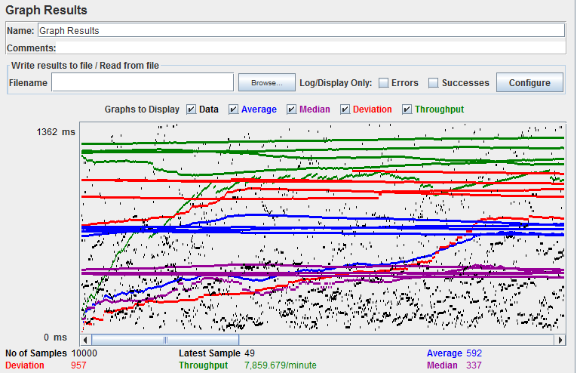
100 Users - 100 Requests per user Without Connection Pooling
CMPE 272

Slide 15
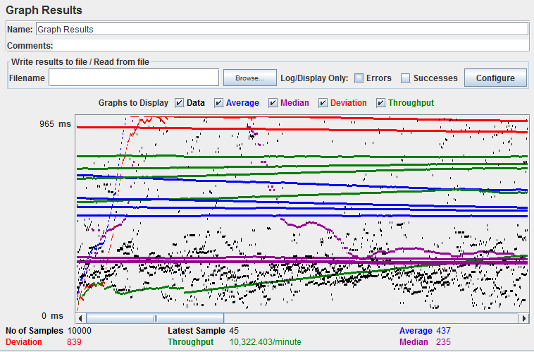
100 Users - 100 Requests per user With Connection Pooling

Slide 16
Thank you

